Slide 1
UI Path RPA Solutions
Automate Extraction of Invoice Details
BY: Shane Artis

Slide 2
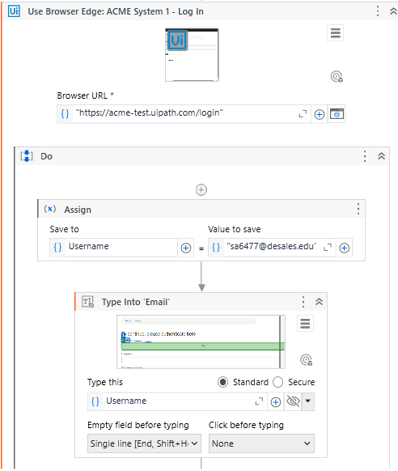
Loging into ACME Website
Built a process using the Modern Design Experience that automates the extraction of invoice details.
1. Read an input Excel file with the invoice numbers.
2. Sign in to the ACME website.

Slide 3
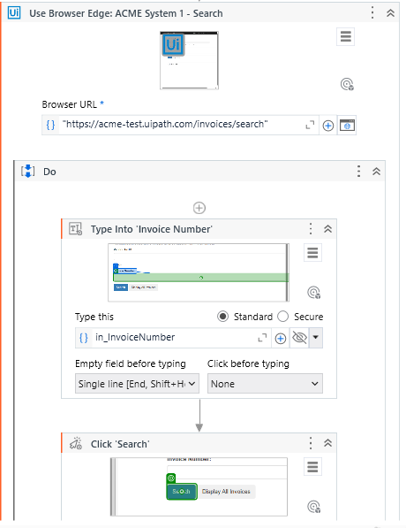
Searching for Invoices
3. Navigate to the invoice search page.
4. For each invoice number in the Excel file, search for the invoice number.

Slide 4
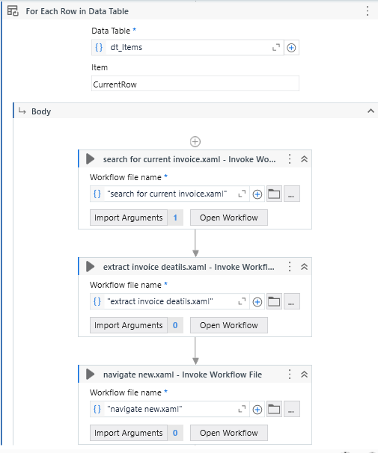
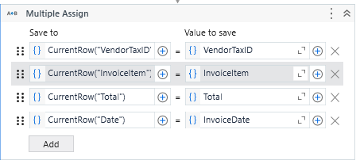
Extracting Invoice
5. Extract the invoice details, including Vendor Tax ID, Invoice Item, Total, and Date.

Slide 5
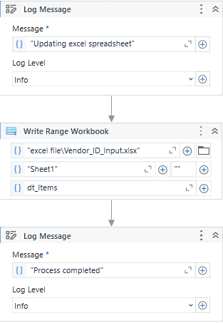
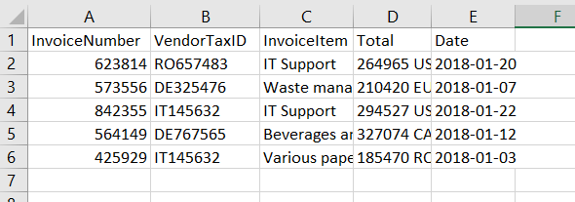
Write in Excel File
6. Write the extracted invoice details to an Excel file stored in the project folder.

